Slide 1
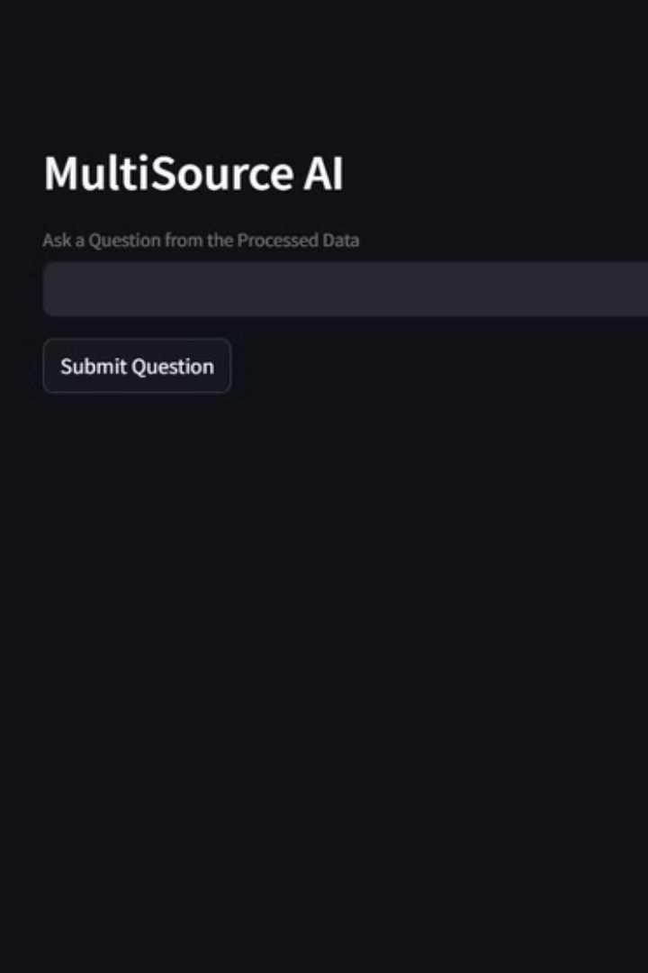

MultiSource AI:A Web Application for Question Answering from Various Sources
MultiSource AI answers user queries by extracting data from different sources. Sources include PDFs, website URLs, YouTube videos, and images.
by Abid

Slide 2
Introducing MultiSource AI
Intelligent Web Application
Multi-Source Data
MultiSource AI is designed to answer user queries effectively.
PDF Documents
It can take multiple files at a time.
Website URLs
YouTube Videos
It can save a lot of time for the users.
Images (OCR)

Slide 3




System Architecture
Data Ingestion
Collects data from different sources.
Text Processing
Cleans and chunks extracted text.
Vector Storage (FAISS)
Stores text embeddings efficiently.
Generative AI (Gemini Model)
Powers question answering.

Slide 4
Key Technologies
Streamlit
Web Application
Langchain
Text Processing
FAISS
Vector Database
Google Generative AI
Embeddings & Chat Model
PyPDF2
PDF Text Extraction
BeautifulSoup
Website Scraping
YouTubeTranscriptAPI
YouTube Transcripts
pytesseract
OCR from Images

Slide 5

Implemented Functional Modules
PDF Text Extraction - PdfReader
Website Content Scraper - BeautifulSoup
YouTube Transcript Fetcher - YouTubeTranscriptApi
Image Text Processing - pytesseract

Slide 6
Data Processing Workflow
Extract Raw Text
Split into Chunks
Store Embedded Texts
1
2
3
4
5
Clean the data
Generate Embeddings
Notes:
The data processing workflow is a multi-step process that takes raw text data and transforms it into a format that can be effectively stored, searched, and retrieved. The first step is to extract the raw text from the source data. This could involve scraping web pages, parsing documents, or extracting text from other formats. Next, we clean and preprocess the raw text. This may include tasks like removing formatting, correcting spelling and grammar, and normalizing the text. After cleaning, we split the text into smaller, more manageable chunks. This helps with storage and makes the data easier to work with. The final step before storage is to generate embeddings for each text chunk. Embeddings are numerical representations of the text that capture the semantic meaning and relationships between words. The overall process involves extraction, cleaning, chunking, embedding, storing, searching, and retrieving the data. We'll cover the full workflow in more detail as we go through the presentation.

Slide 7





Question Answering Flow
User Question
The user submits a question.
Similarity Search
Find relevant text chunks.
Retrieve Chunks
Load relevant documents.
Pass to QA Chain
Use Gemini model.
Output Answer
Display the generated answer.

Slide 8





Key Features Highlight
Multi-source
Real-time
User-friendly
Time Saver

Slide 9
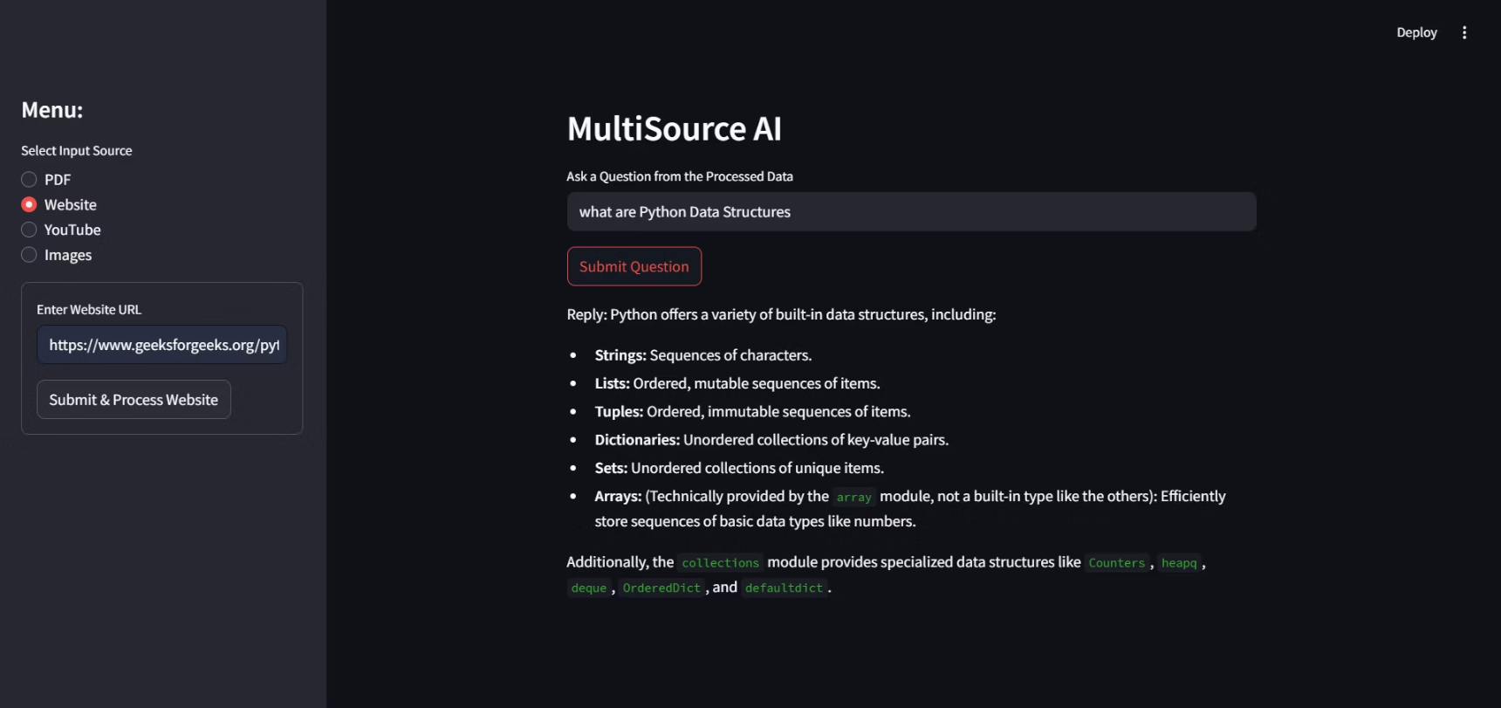
Application Screenshots

Slide 10
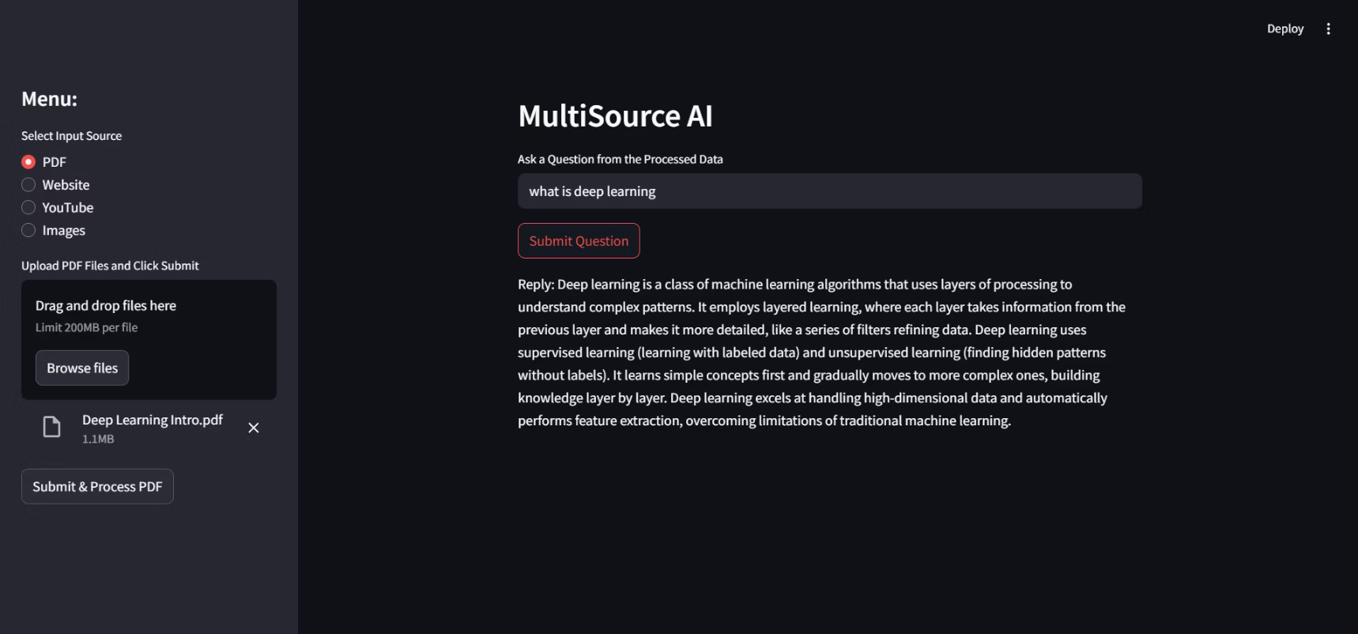
Application Screenshots

Slide 11
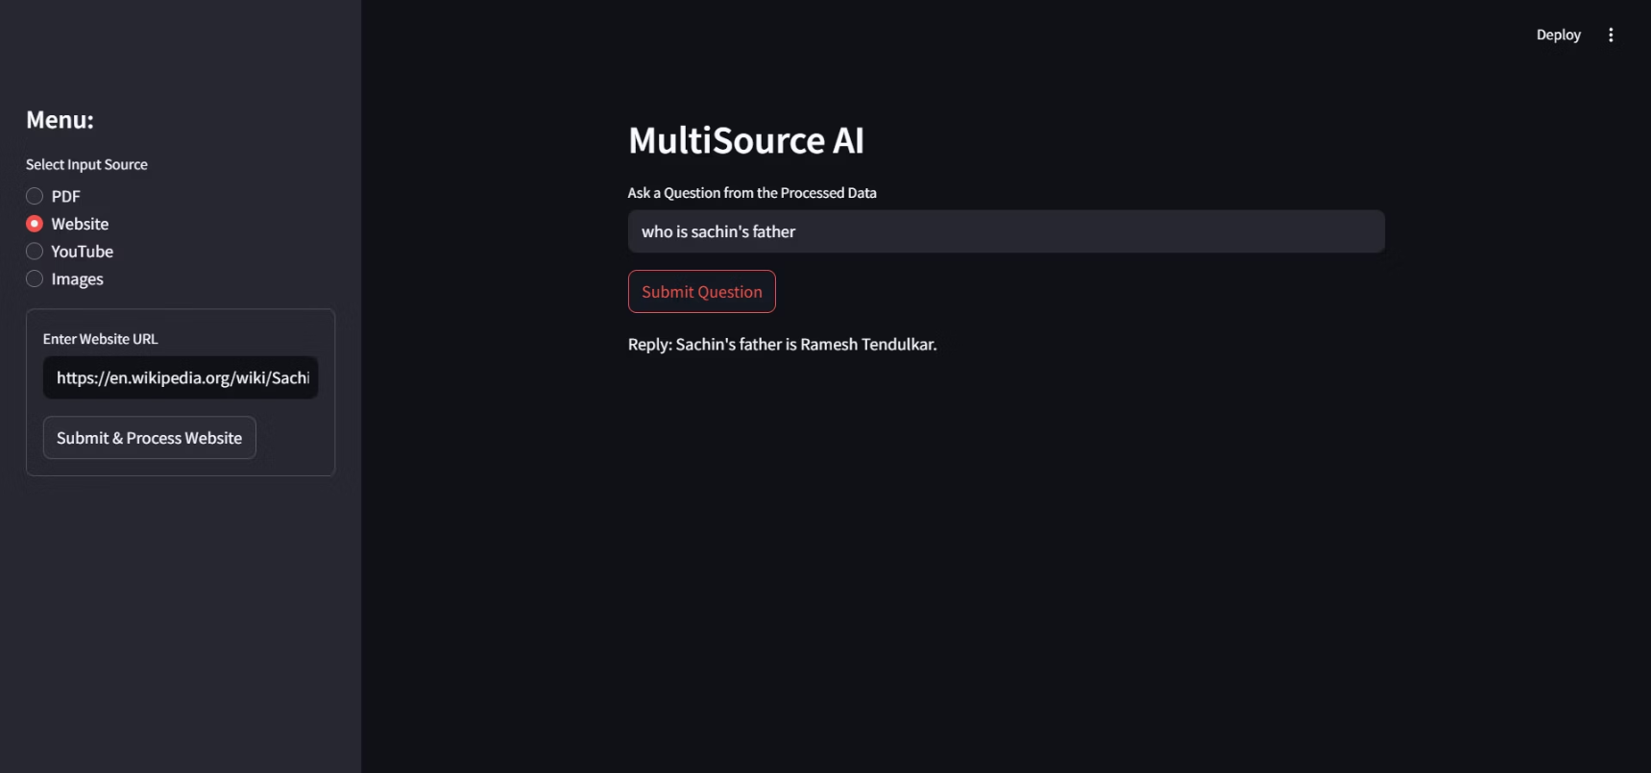
Application Screenshots

Slide 12
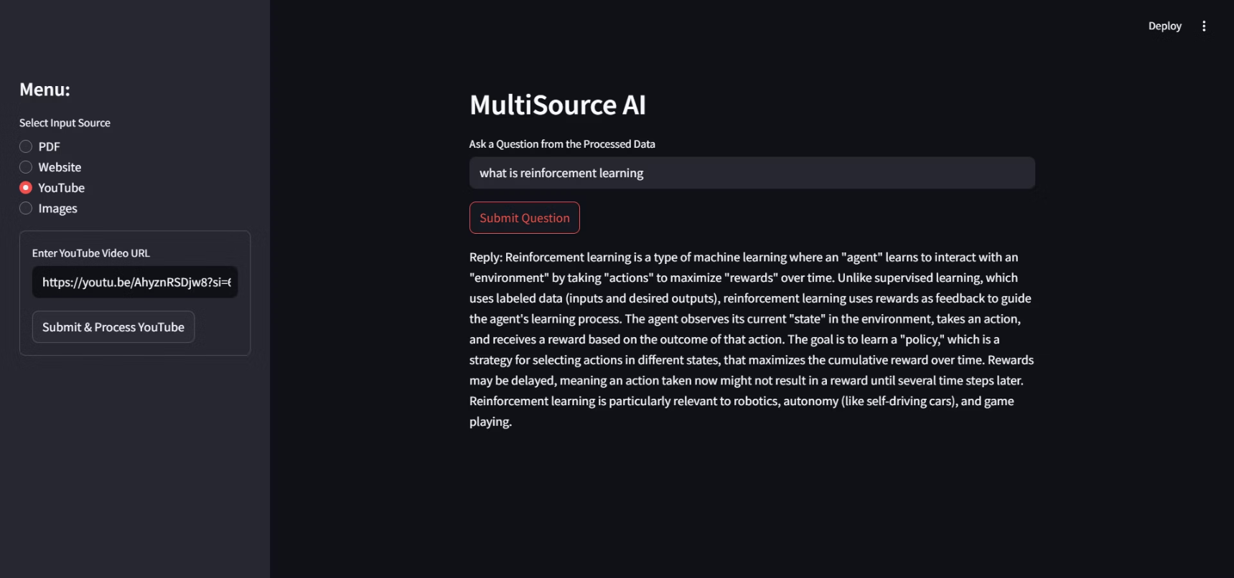
Application Screenshots

Slide 13
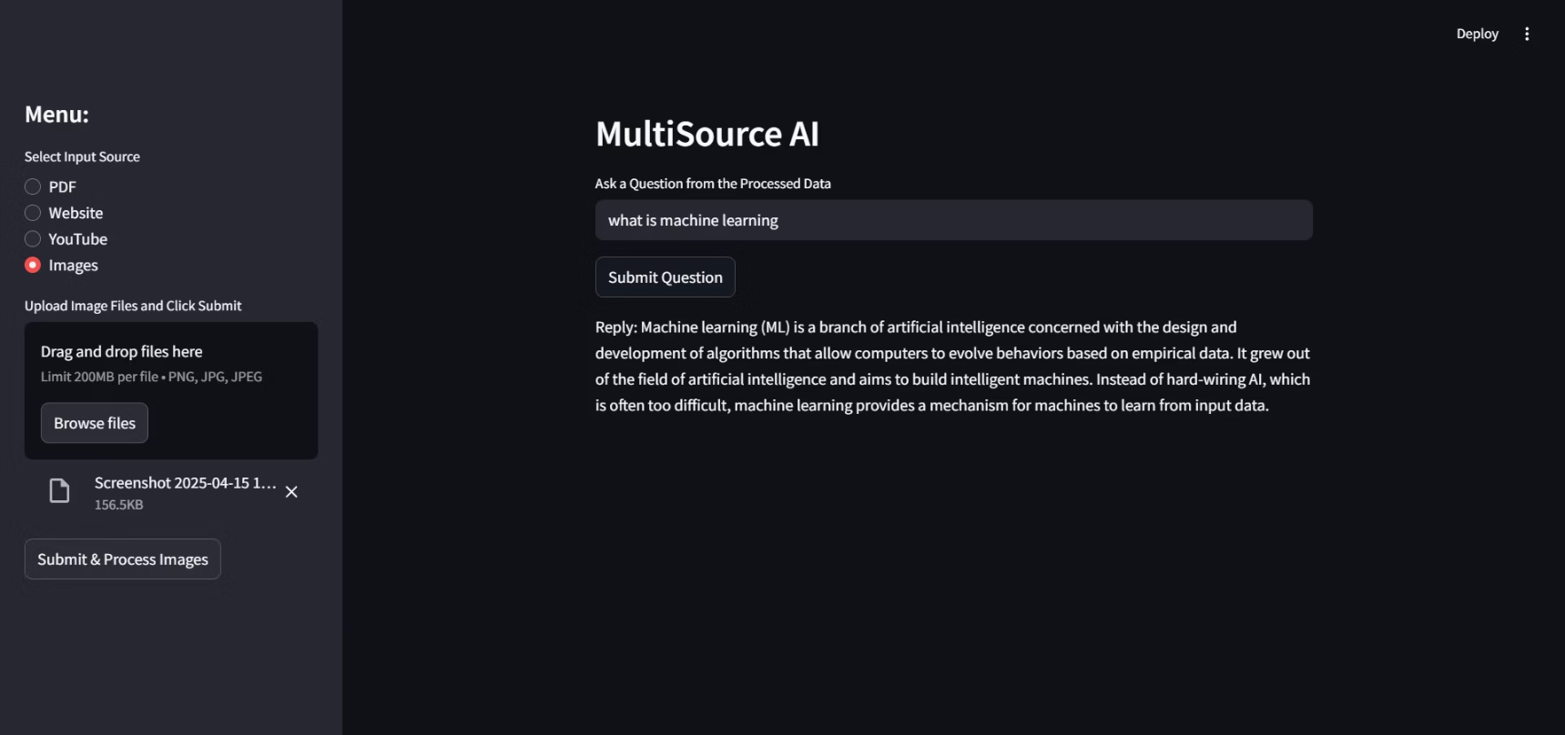
Application Screenshots

Slide 14

Thank You…

